Slide 1
FriDAY
August 14th, 2015
Day 5

Slide 2
Morning Work
Agenda Book
Reading Log Check

Slide 3
Reading
Reading Buddies

Slide 4
Specials
Art

Slide 5
Grammar
Number your Notebook

Slide 6
Writing
Blogs

Slide 7
Reminders
Forms and Fees
Supplies
Healthy Foods

Slide 8
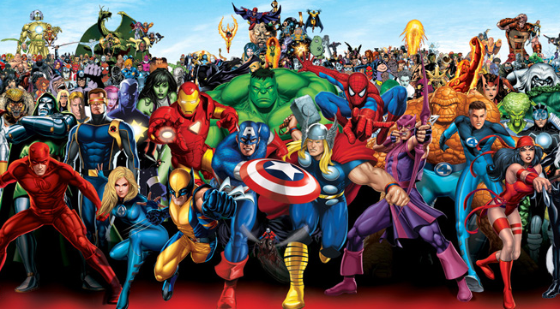
Super Learners
in Training

